Slide 1

Student Management Application
Presented by
===========
Dhanush
Saikiran
Bhavana
Pooja

Slide 2
Index
Requirement Document
Test Plan
Source code(Version 1 and 2)
Console View
Database View
Test Scenario
Test Cases
Defect Log
RTM
Modules
Project Overview

Slide 3
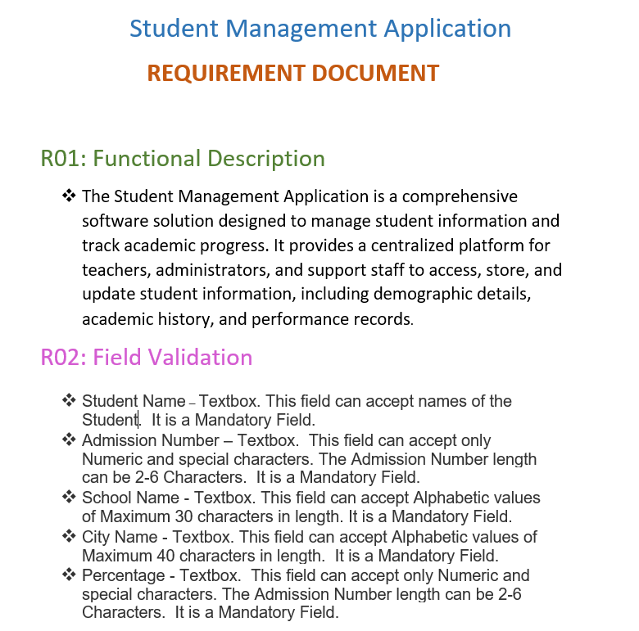
Requirement Document

Slide 4
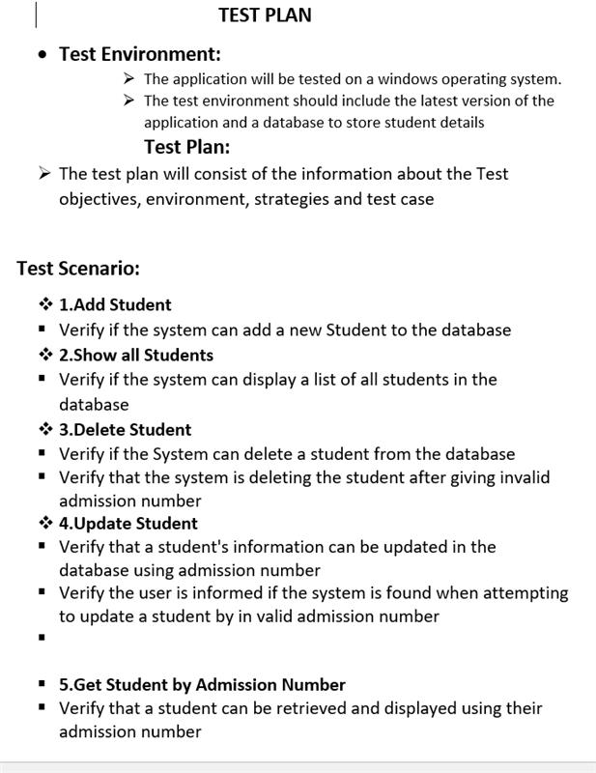
Test Plan

Slide 5
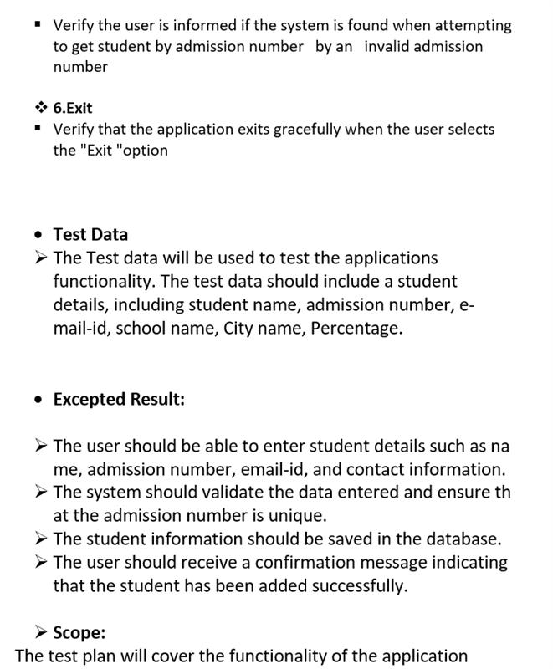
Test Plan

Slide 6
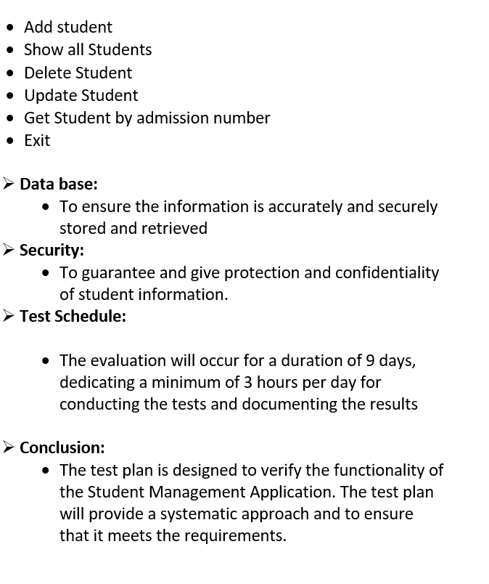
Test Plan

Slide 7
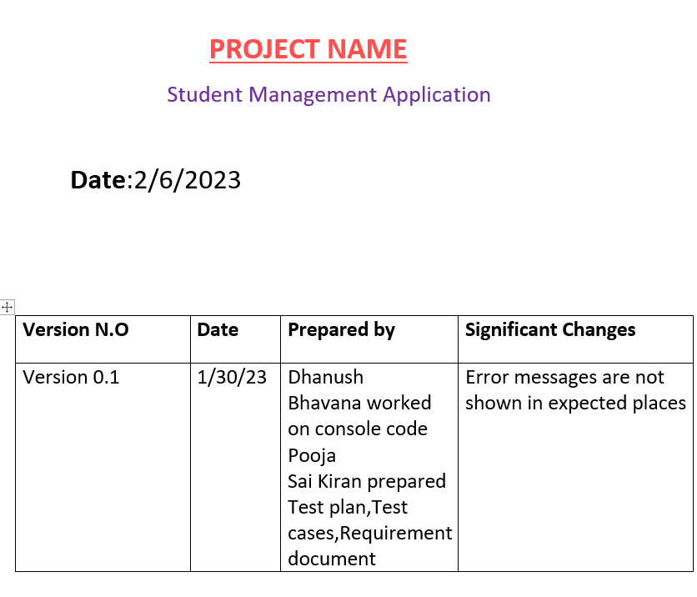
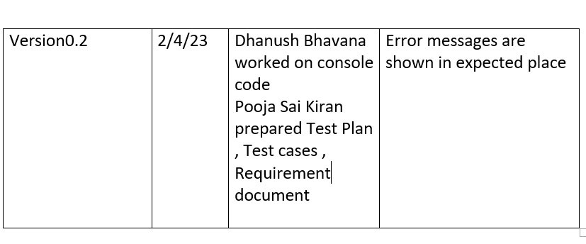
Project Template

Slide 8
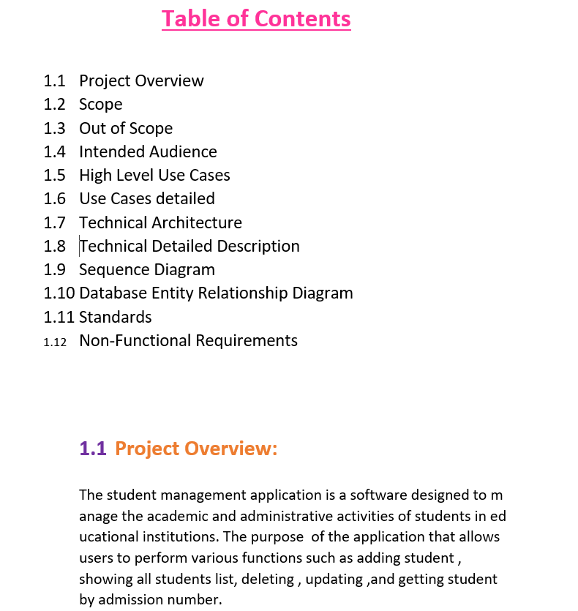
Project Template

Slide 9
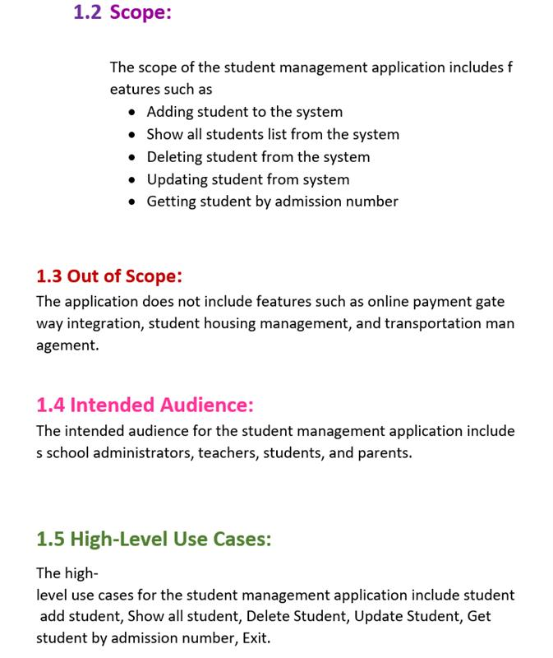
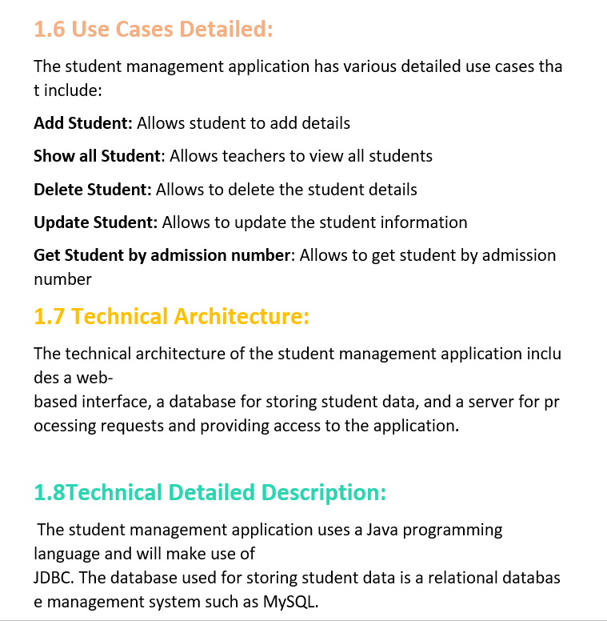
Project Template

Slide 10
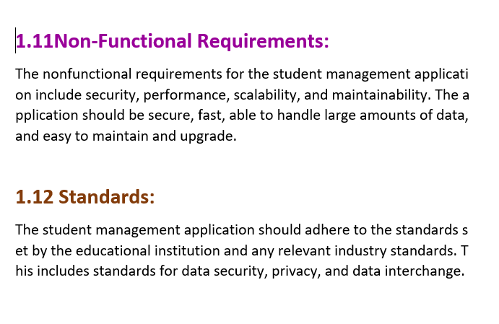
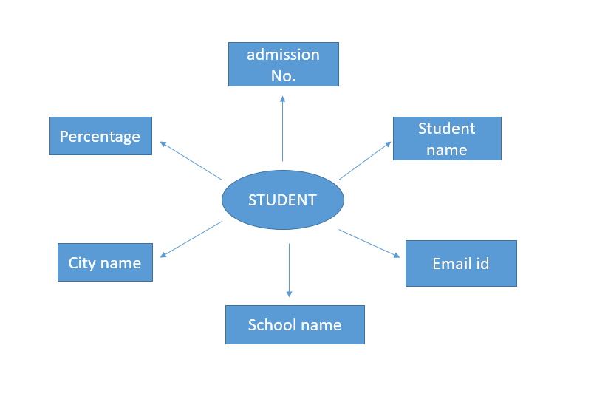
Project Template
Entity Relationship Diagram

Slide 11
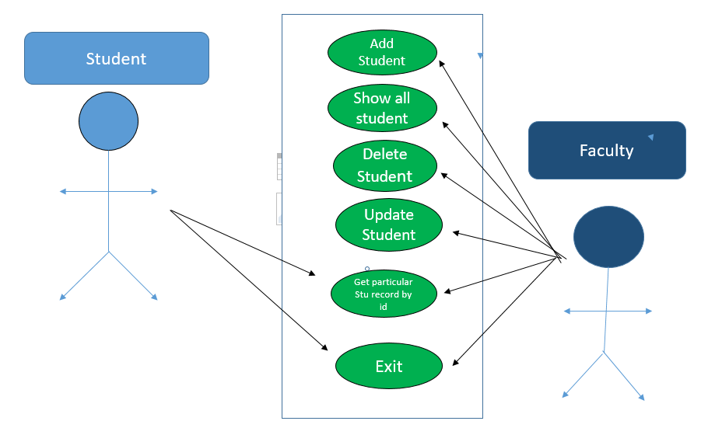
High Level Use Cases

Slide 12
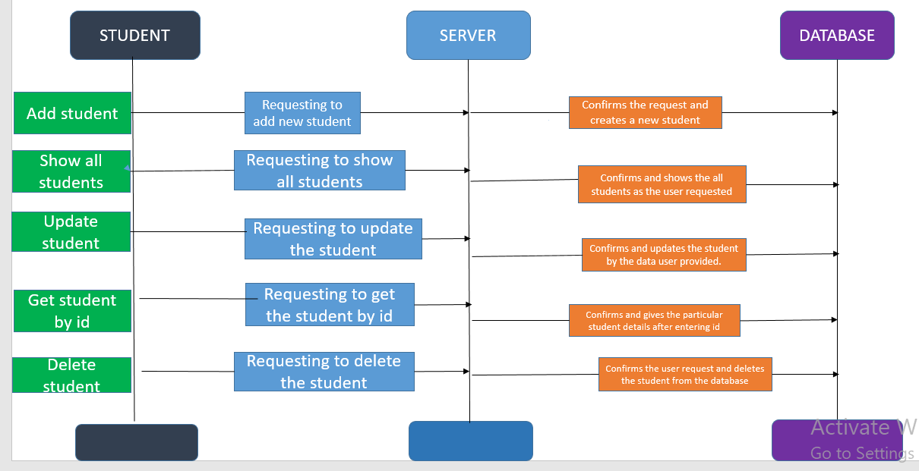
Sequence Diagram

Slide 13
Modules
Add
Add students
Show
Show All Students
Delete
Delete Student
Update
Update Student
Get
Get Student based on roll number
Exit
Exit Student

Slide 14
PROJECT OVERVIEW
The Student Management Application that helps schools keep track of student's information.
The goal of this application is to make it easier for schools to organize and access student information.
This application make management to communicate with students and parents via e-mail or SMS.

Slide 15
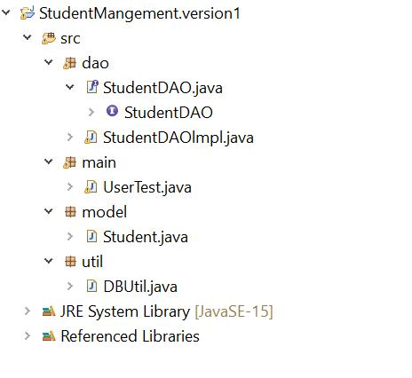
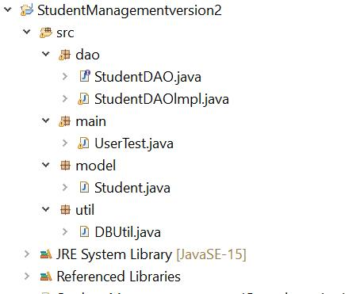
Source Code Project Structure

Slide 16
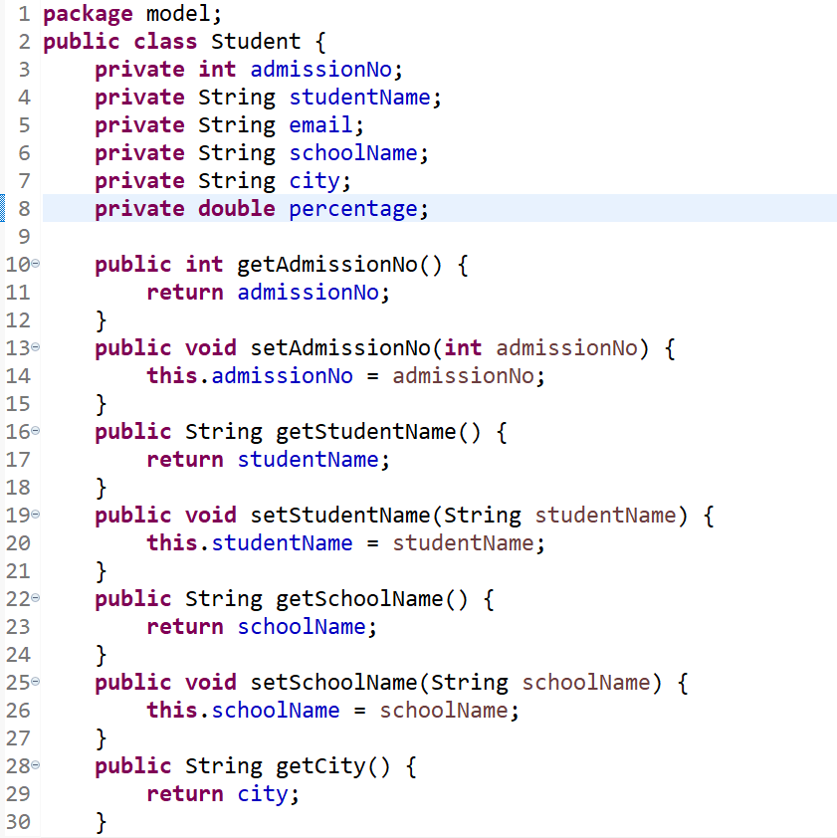
Model Class

Slide 17
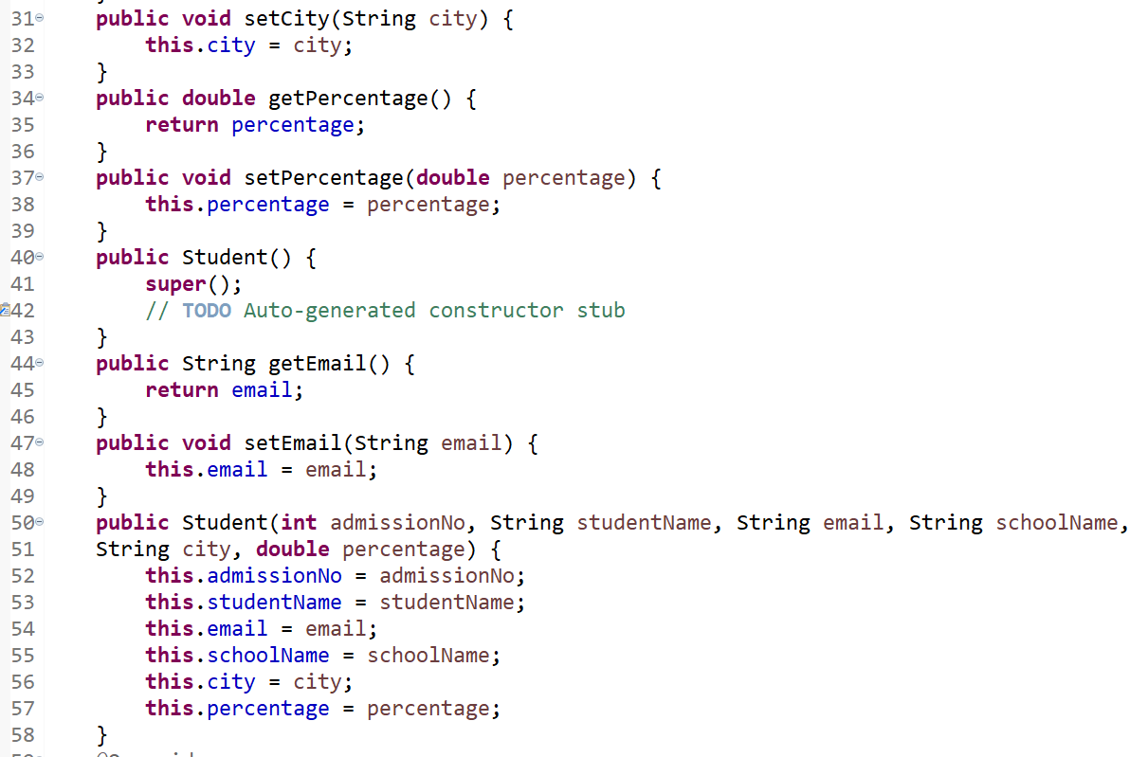
Model Class

Slide 18
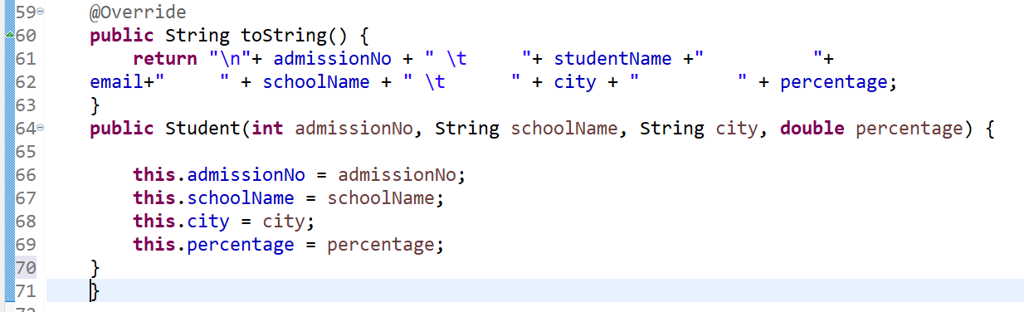

Slide 19
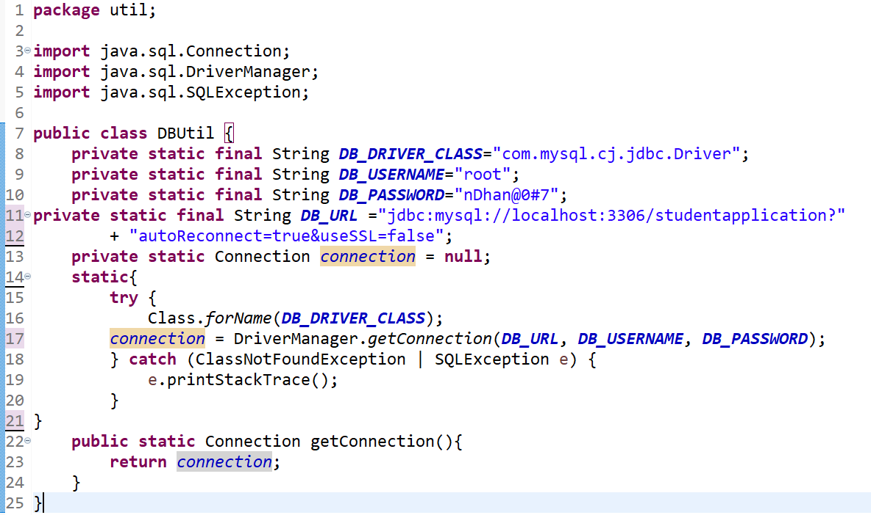
Database connection in DBUtil class

Slide 20
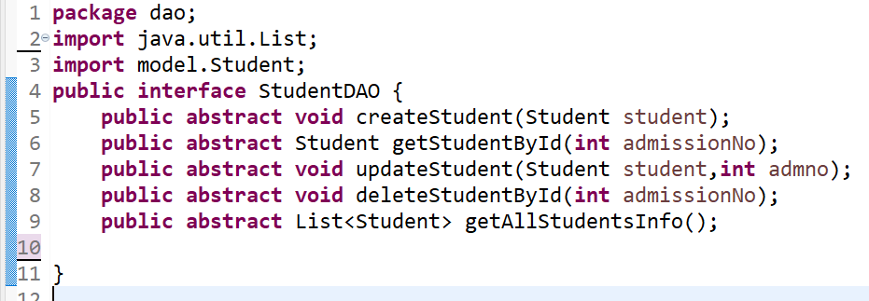
StudentDAO Interface

Slide 21
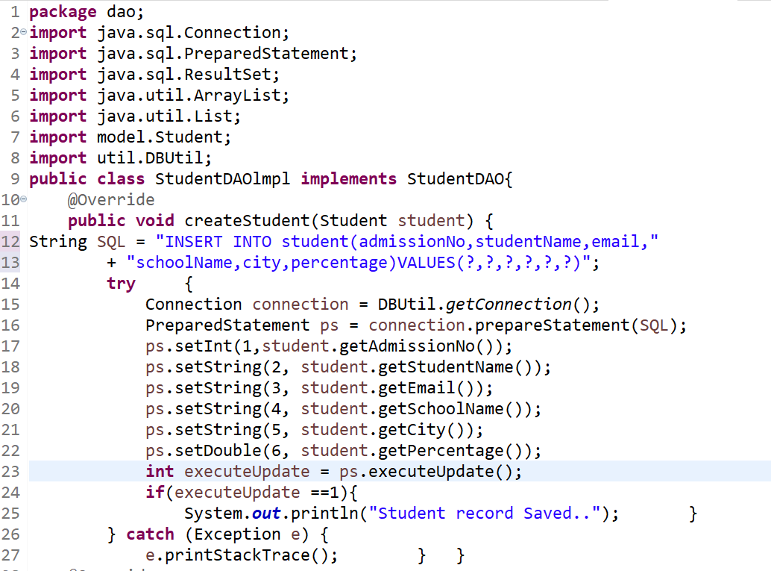
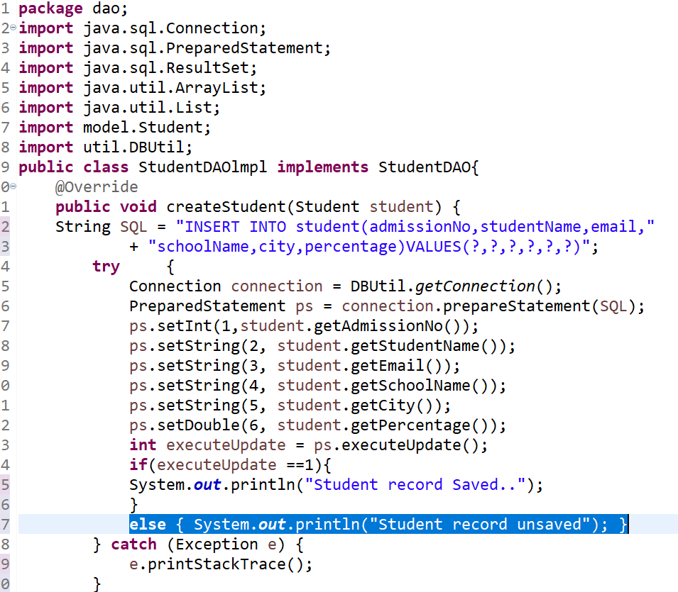
StudentDAO implements
Version 2
Version 1
.

Slide 22
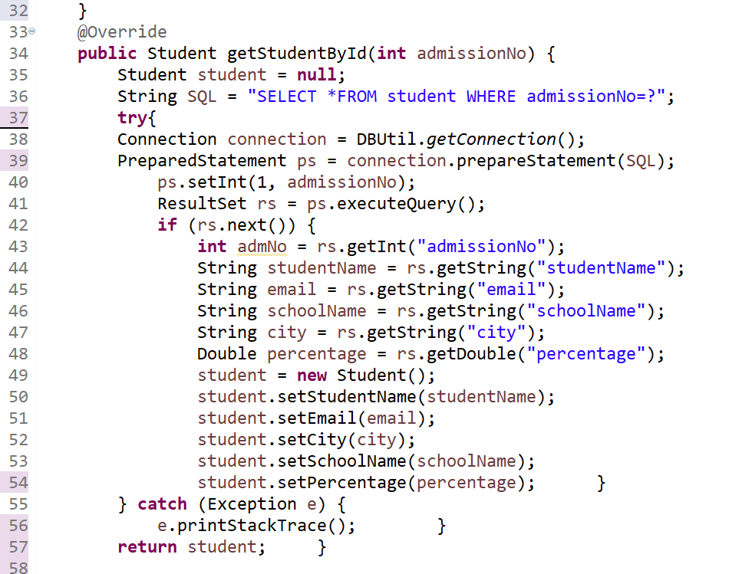
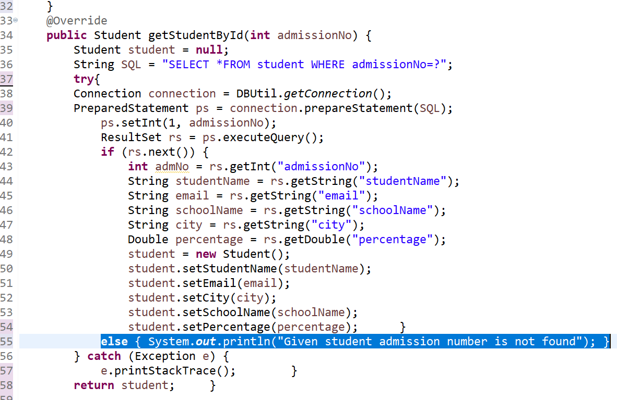
StudentDAO implements
Version 1
Version 2

Slide 23
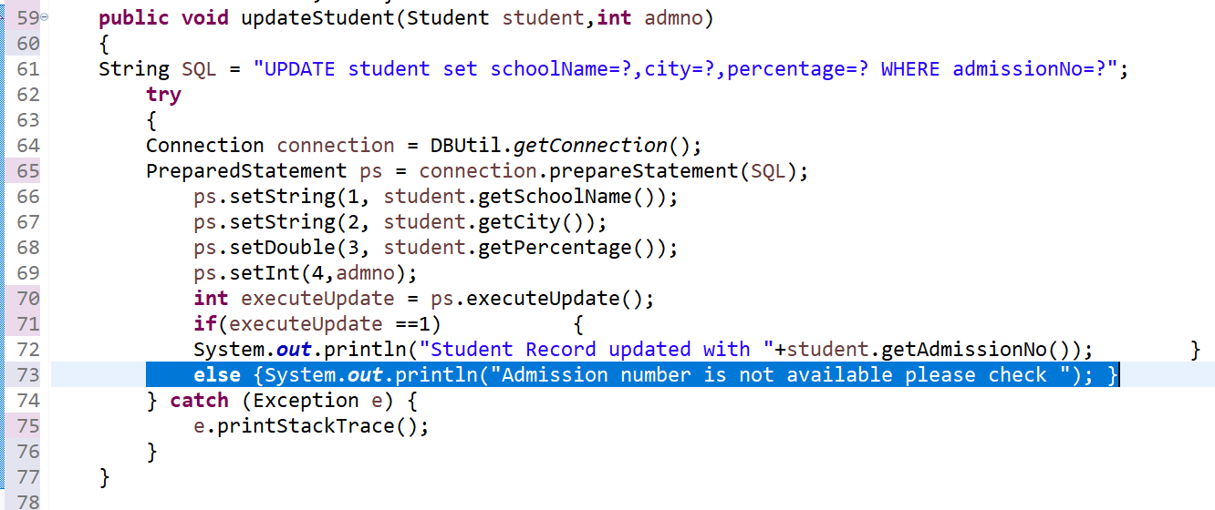
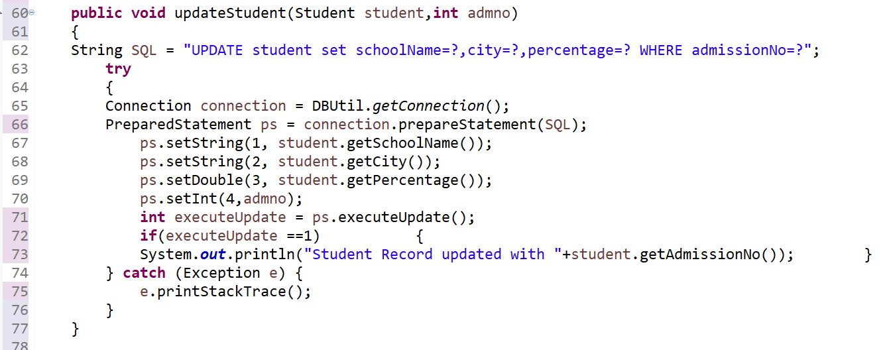
StudentDAO implements
Version 1
Version 2

Slide 24
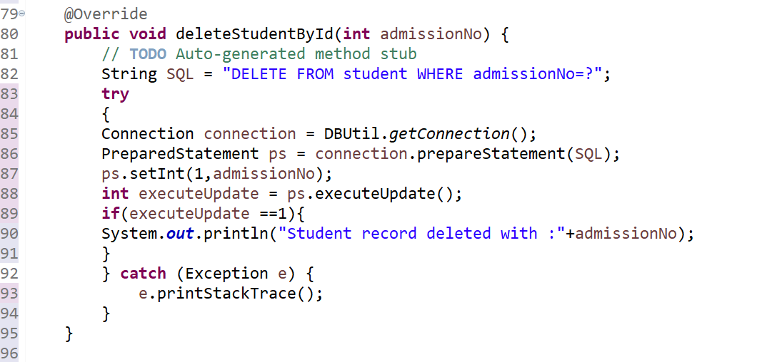
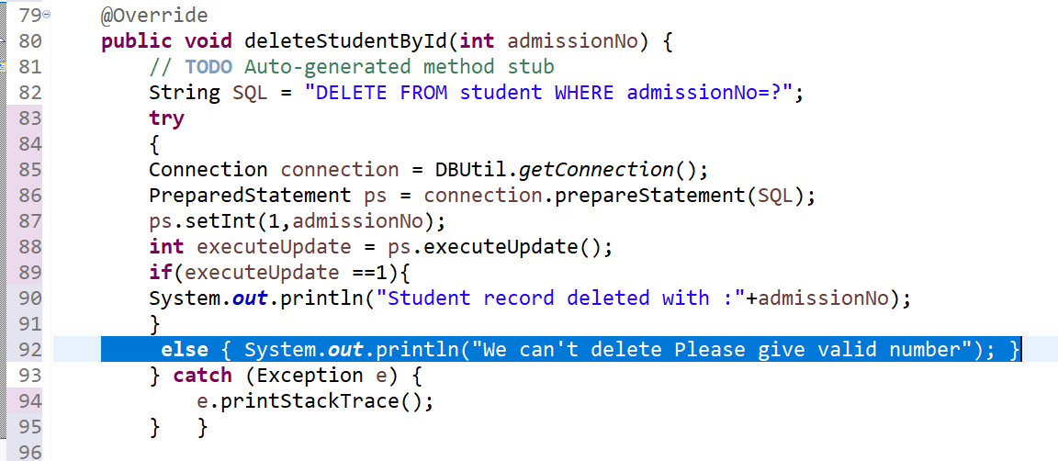
StudentDAO implements
Version 2
Version 1

Slide 25
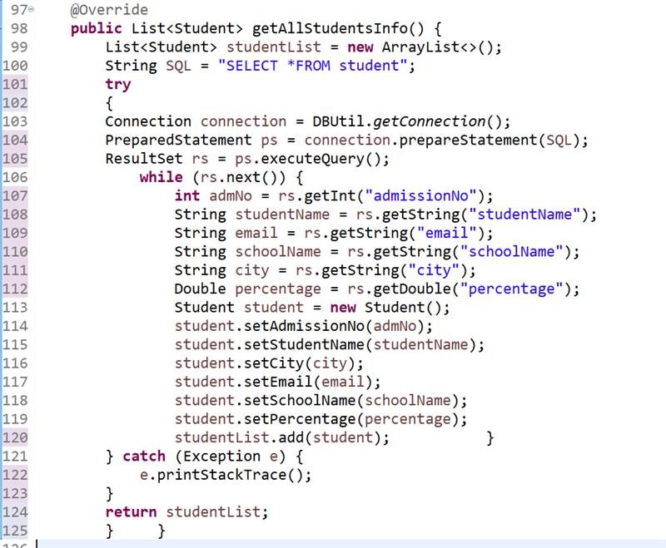
StudentDAO implements

Slide 26
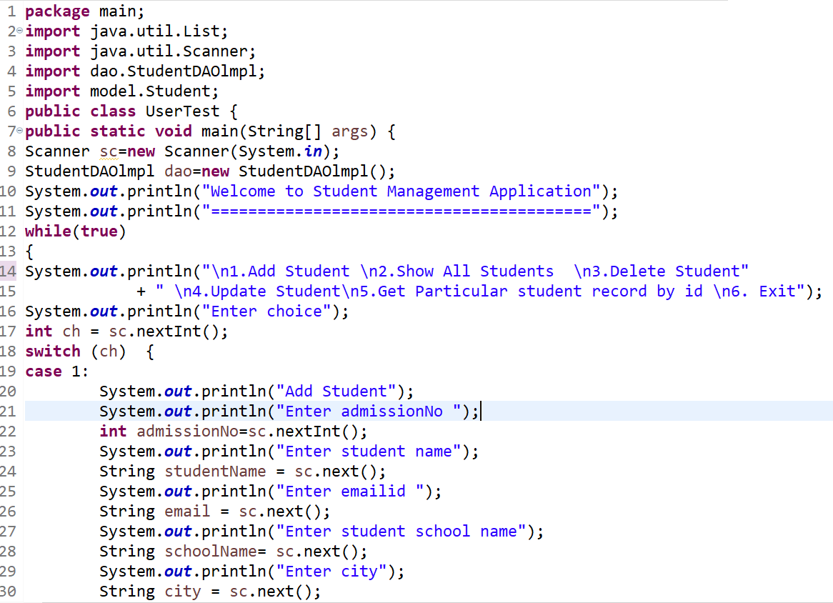
Main Class

Slide 27
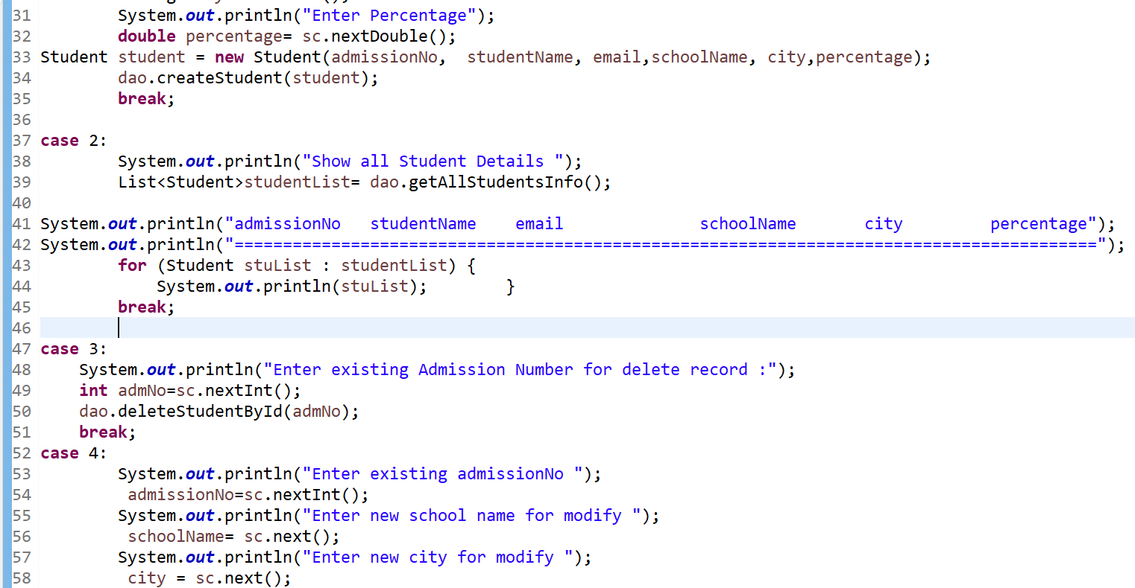
Main Class

Slide 28
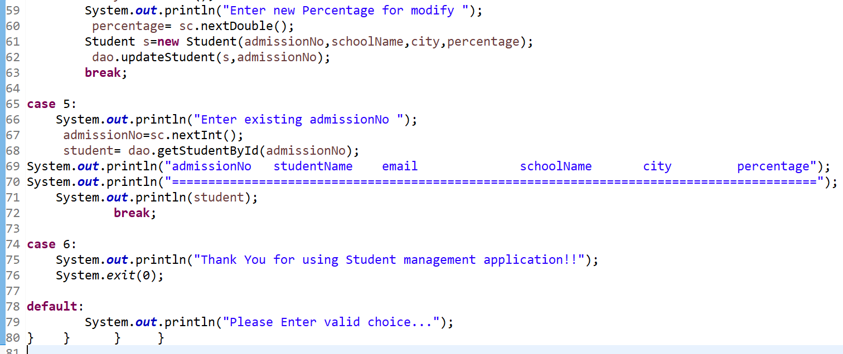
Main Class

Slide 29
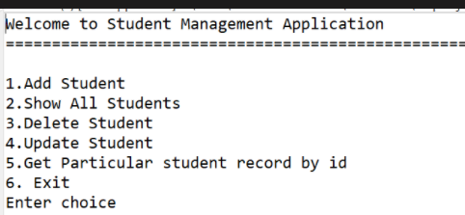
WELCOME MODULE
...

Slide 30
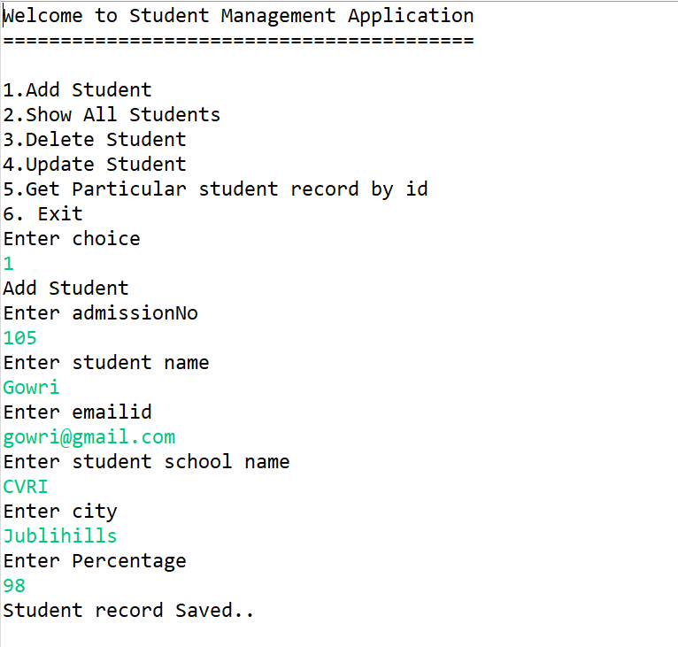
ADD STUDENTS
..

Slide 31
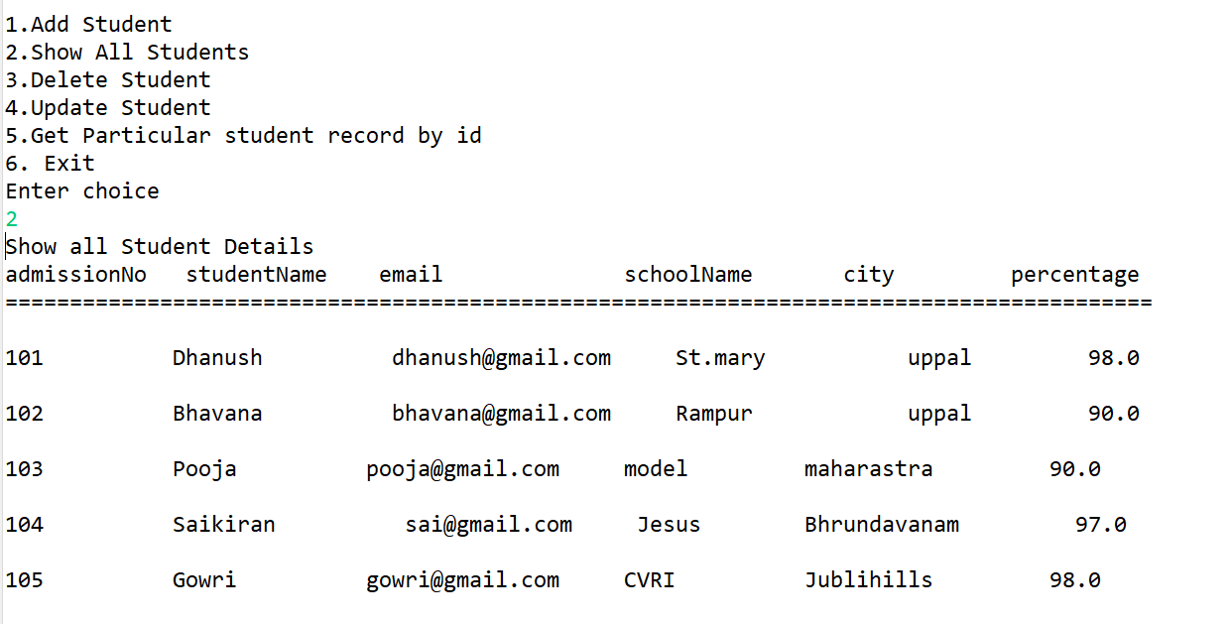
Show All Students
..

Slide 32
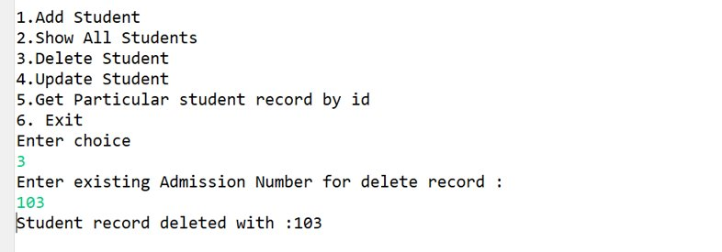
Delete Student

Slide 33
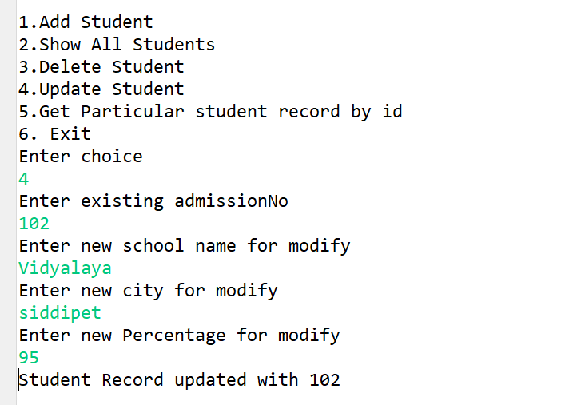
Update Student

Slide 34
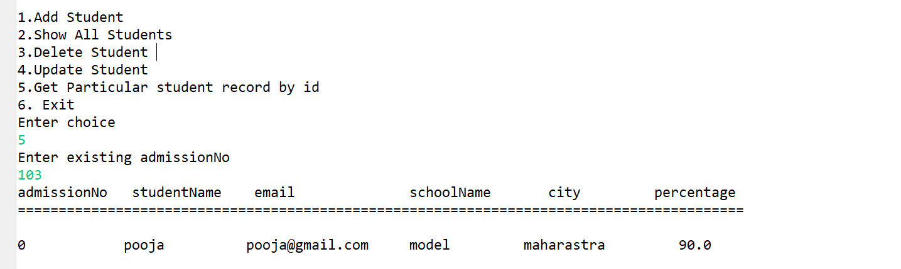
Get student based on admission no

Slide 35
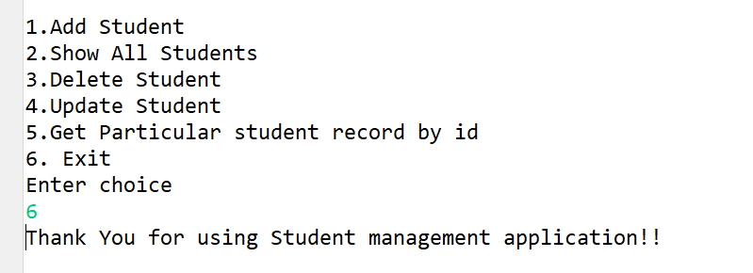
Exit

Slide 36
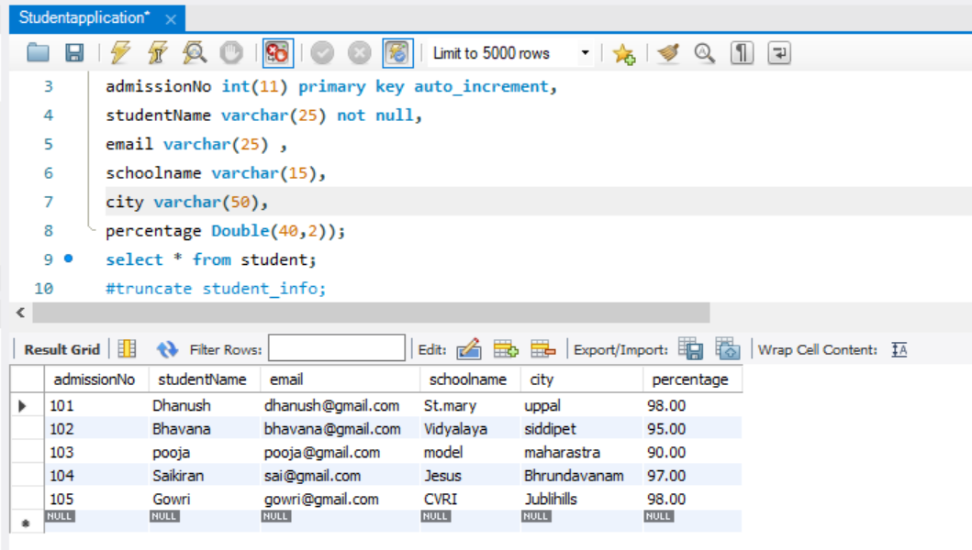
SQL DATABASE

Slide 37
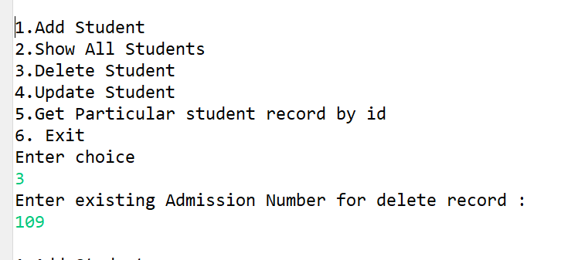
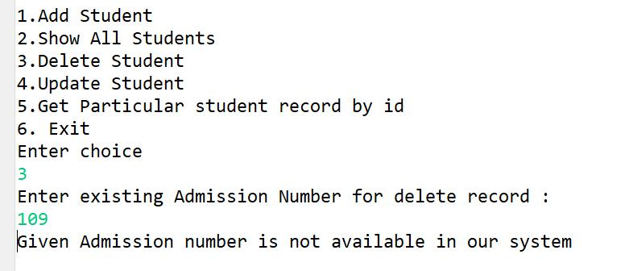
Defect in Delete Module.
Invalid
Valid

Slide 38
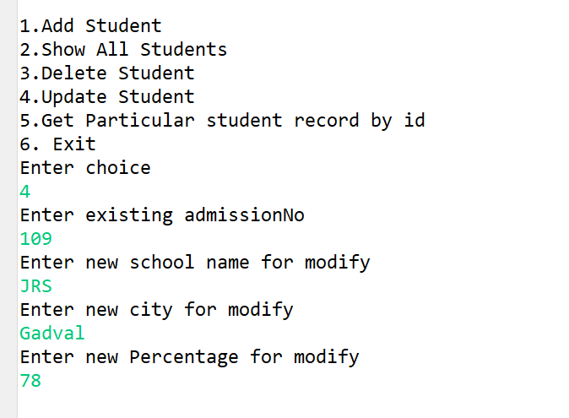
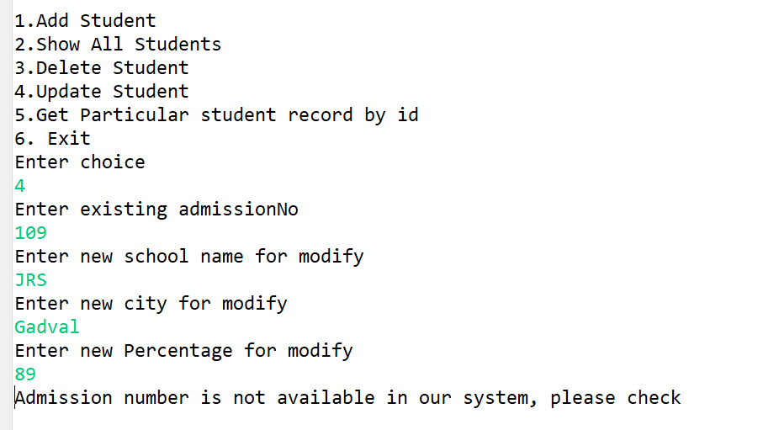
Defect In Update
Invalid
Valid

Slide 39
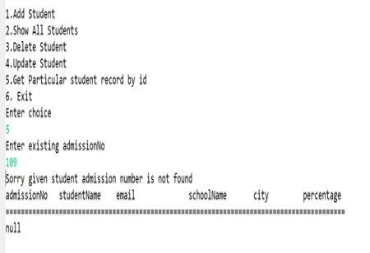
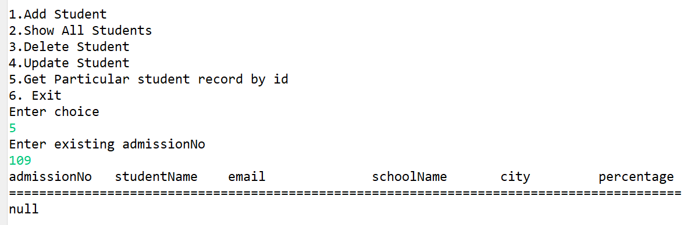
Defect in Get Student by ID
Invalid
Valid

Slide 40
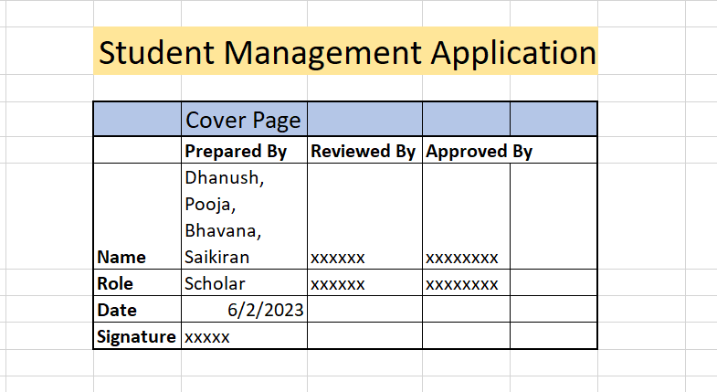
Cover Page

Slide 41
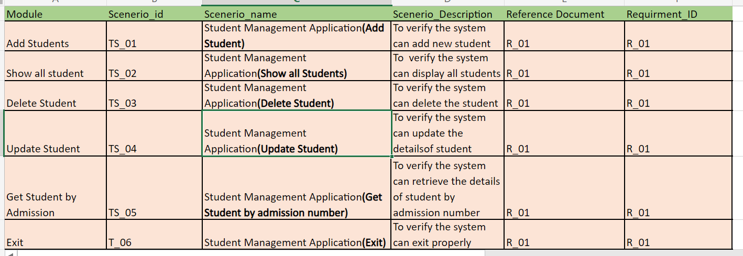
Test Scenarios

Slide 42
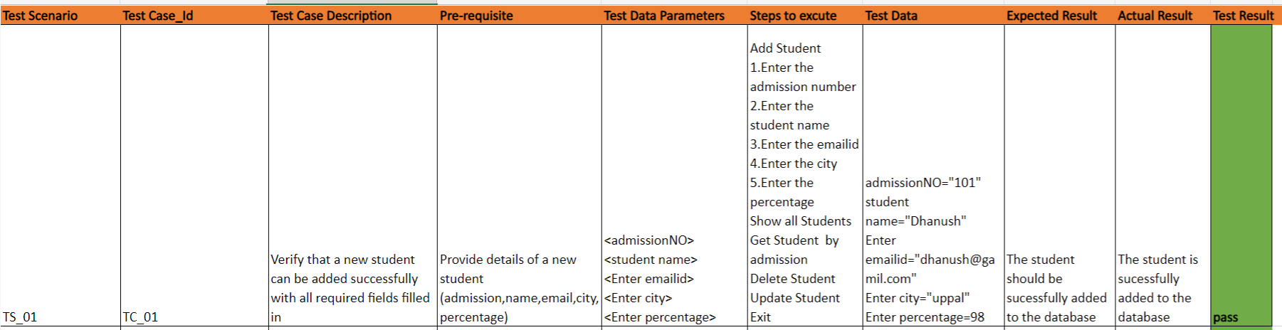
Test Case 1

Slide 43
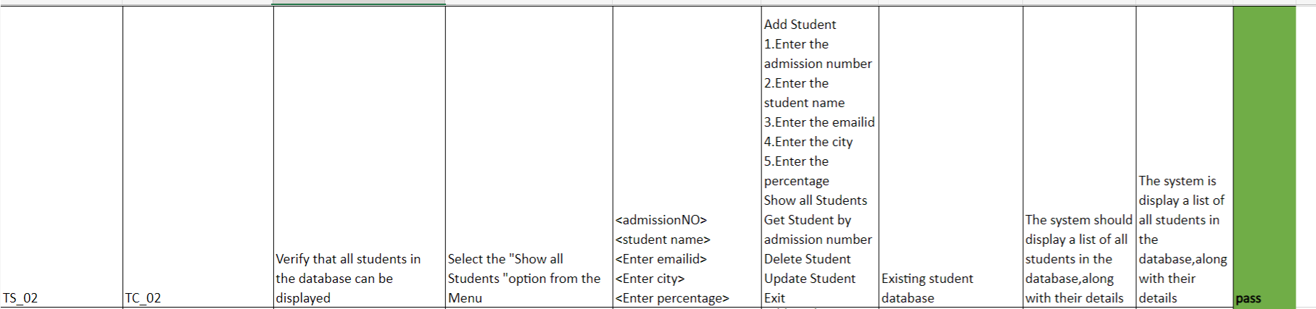
Test case 2

Slide 44
Test case 3

Slide 45

Test case 4

Slide 46

Test case 5

Slide 47

Test case 6

Slide 48

Test case 7

Slide 49

Test case 8

Slide 50

Test case 9

Slide 51

Defect Log

Slide 52

Defect Log

Slide 53

Defect Log

Slide 54

RTM

Slide 55

Automation
For Swag Labs
This Photo by Unknown author is licensed under CC BY-SA-NC.

Slide 56


Slide 57
Project Overview
We automate the demo website name is "SwagLabs"
https://www.saucedemo.com
We are tested the functionality by Creating the Page Objects and classes of the Signing in, Product catalog, Purchase and User is able to.
We have added Extent Report and TestNG emailable Report for each test case.

Slide 58


Defects
Username: standard_user
Username: problem_user

Slide 59


Slide 60


Slide 61

Swag Labs Demo - Automation
Structure of the Project

Slide 62

Source Code Page Object_01

Slide 63


Page object_02

Slide 64


Page object_03

Slide 65


Page Objects_04

Slide 66


Data Provider

Slide 67

Data Provider

Slide 68


Data Provider

Slide 69


Test Case_01

Slide 70

Signing module extent report

Slide 71


Test Case_02

Slide 72

Signing module extent report

Slide 73


Test Case_03

Slide 74

Signing module extent report

Slide 75


Test Case_04

Slide 76

Test Case_04

Slide 77

Product catalog module extent report

Slide 78


Test Case_05

Slide 79

Test Case_05

Slide 80

Product catalog module extent report

Slide 81


Test Case_06

Slide 82

Test Case_06

Slide 83

Product catalog module extent report

Slide 84


Test Case_07

Slide 85

Test Case_07

Slide 86

Product catalog module extent report

Slide 87


Test Case_08

Slide 88

Test Case_08

Slide 89

Purchase module extent report

Slide 90


Test Case_09

Slide 91

Test Case_09

Slide 92

Purchase module extent report

Slide 93


Test Case_10

Slide 94


Test Case_10

Slide 95

Purchase module extent report

Slide 96


Test Case_11

Slide 97


Test Case_11

Slide 98

Purchase module extent report

Slide 99


Test Case_12

Slide 100

Test Case_12

Slide 101

ExtentReport

Slide 102

Test Suite

Slide 103

TestNG emailable report

Slide 104
GitHub link
https://github.com/dhanu0823/practice-Project.git

Slide 105
Thank You

